Slide 1
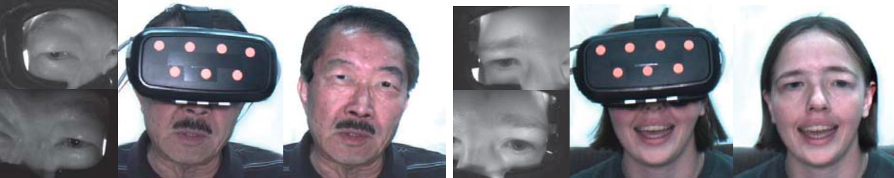
Mask-off: Synthesizing Face Images in the Presence of Head-mounted Displays
Notes:
VR and AR tech is evolving fast, offering us incredible immersive experiences.
Yet, the headsets we wear in these virtual spaces make it tough to have a real face-to-face chat,
It's a problem that's especially tricky in teamwork and nuanced communication

Slide 2
Related Work
Facial Performance Capture
Face Reconstruction and Appearance Synthesis
Headset Removal
Notes:
Researchers are focusing their efforts on three main areas to smooth out these communication bumps.
I'm about to walk you through the highlights of their work in these areas.
通过使用高分辨率摄像头和其他传感器捕捉人类面部表情的微妙变化
Capturing subtle changes in human facial expressions by using high-resolution cameras and other sensors
从图像或视频中重建一个人的三维面部模型，并可能合成面部的外观，包括纹理和色彩
reconstructing a 3D model of a person's face from an image or video and possibly compositing the appearance of the face, including textures and colors

Slide 3
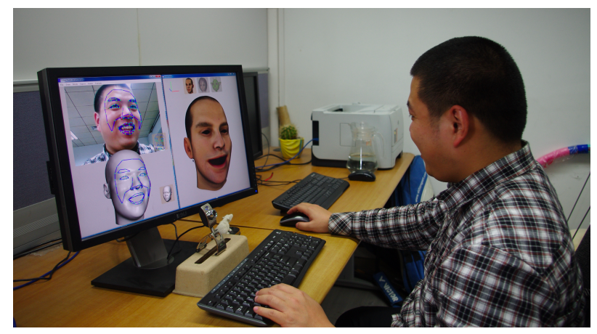
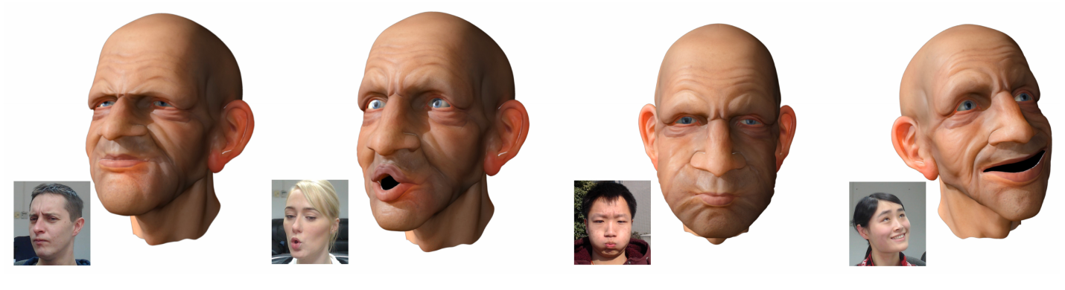
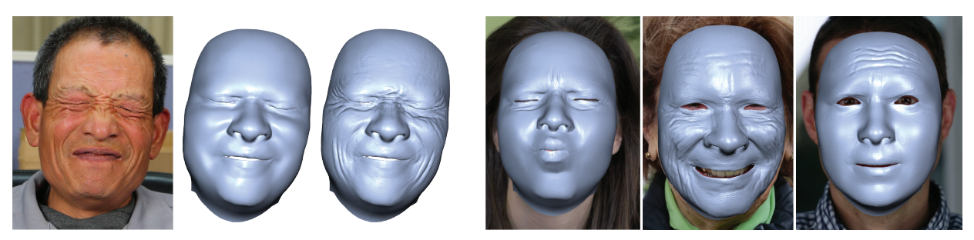
Facial Performance Capture
Dynamic Dense Expression
C. Cao, Y. Weng, S. Lin and K. Zhou, "3d shape regression for real-time facial animation", ACM Transactions on Graphics (TOG), vol. 32, no. 4, pp. 41, 2013.
Chen Cao, Qiming Hou, and Kun Zhou. 2014. Displaced dynamic expression regression for real-time facial tracking and animation. ACM Trans. Graph. 33, 4, Article 43 (July 2014), 10 pages. https://doi.org/10.1145/2601097.2601204
3D shape regression
Still not robust enough for occlusions and unconstrained environments
local regressor
C. Cao, D. Bradley, K. Zhou and T. Beeler, "Real-time high-fidelity facial performance capture", ACM Transactions on Graphics (ToG), vol. 34, no. 4, pp. 46, 2015.
Notes:
The first area focuses on facial performance capture technology.
Various methods have been developed, such as training 3D shape regressors from 2D images,
using DDE models for precise facial feature point inference, and employing local regressors to capture facial details like wrinkles.
These techniques enable real-time capture without the need for user-specific calibration but may face stability issues in obstructed or uncontrolled environments.
使用DDE（Dynamic Dense Expression）回归器来预测面部的2D标志和3D形状。
结合用户的特定面部混合形状和摄像头矩阵调整预测,生成最终的面部形状向量，这个向量可以用来驱动数字化的虚拟人物
尽管皱纹在面部不同区域出现，不同规模变化，但在局部区域它们显示出高度的自相似性。这意味着皱纹的视觉外观和它们局部的形状直接相关。
训练回归器：利用高分辨率的捕捉数据，训练局部回归器来预测在运行时局部外观的局部几何形状。
密集的深度信息和高帧率来捕捉细节，如果遇到遮挡或者环境中的变化大，这些条件可能不满足，导致捕捉的质量下降。系统需要清晰的视野和一致的照明来准确地追踪运动

Slide 4
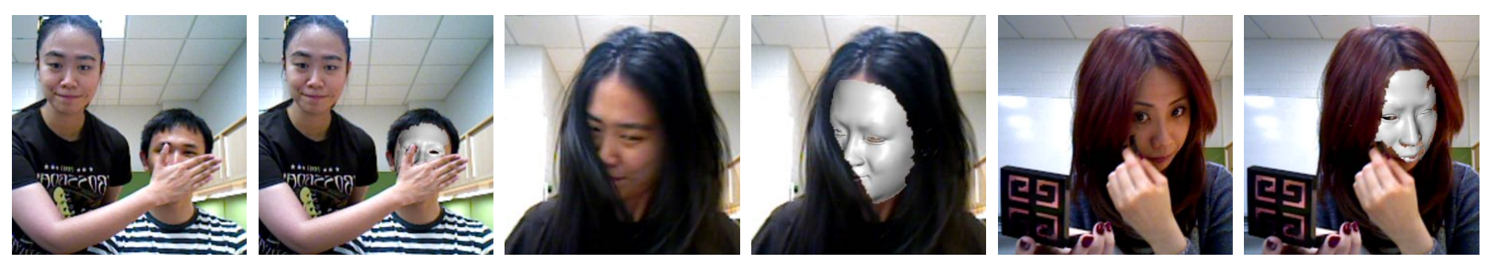
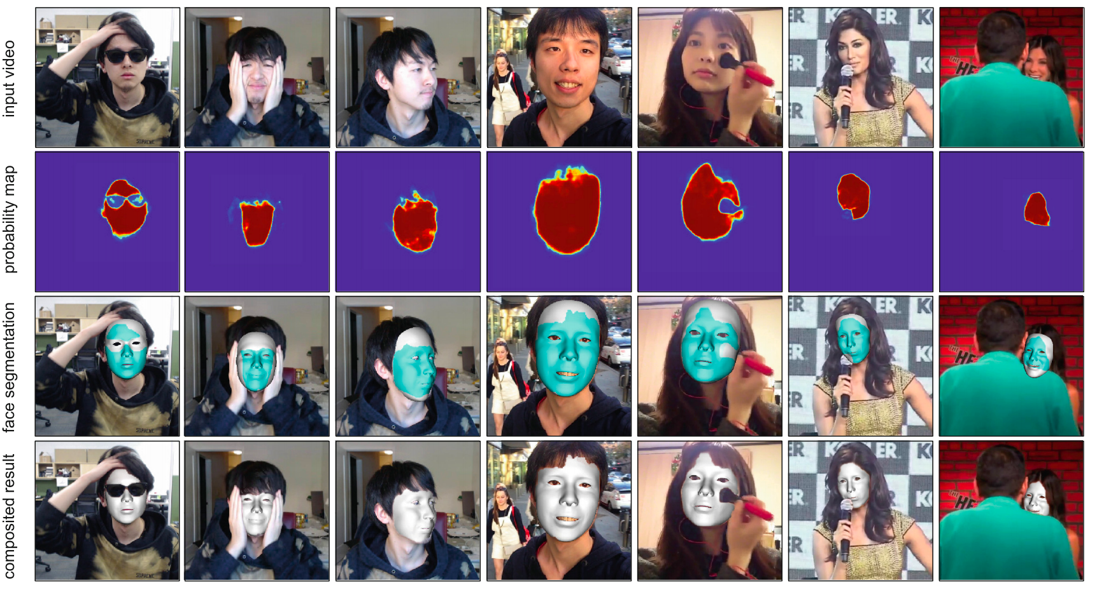
Unconstrained Facial Performance Capture
P.-L. Hsieh, C. Ma, J. Yu and H. Li, "Unconstrained realtime facial performance capture", Proceedings of the IEEE Conference on Computer Vision and Pattern Recognition, pp. 1675-1683, 2015.
RGB-D sensors
S. Saito, T. Li and H. Li, "Real-time facial segmentation and performance capture from rgb input", European Conference on Computer Vision, pp. 244-261, 2016.
CNN based facial segmentation
Notes:
To address these challenges, the researchers proposed some new technologies like using common RGB-D sensors and convolutional neural network-based facial segmentation, and that enables continuous facial feature tracking even in the presence of obstructions like hair, gestures, or accessories, and that lay the groundwork for headset removal.
在追踪过程中，系统通过检测形状和外观输入中的异常值来显式分割面部区域和任何遮挡部分，这是通过使用指数平滑和用户适应的追踪模型作为先验来实现的。
作者提出了一种深度卷积神经网络架构，可以实时处理RGB输入数据，有效地识别和分割面部区域，即使在面部部分被遮挡的情况下。通过这种方法，系统能够更准确地追踪面部动作，因为它专注于已经分割好的面部区域，而不是整个图像，这减少了问题的复杂度。

Slide 5
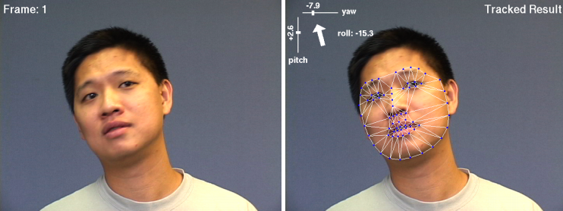
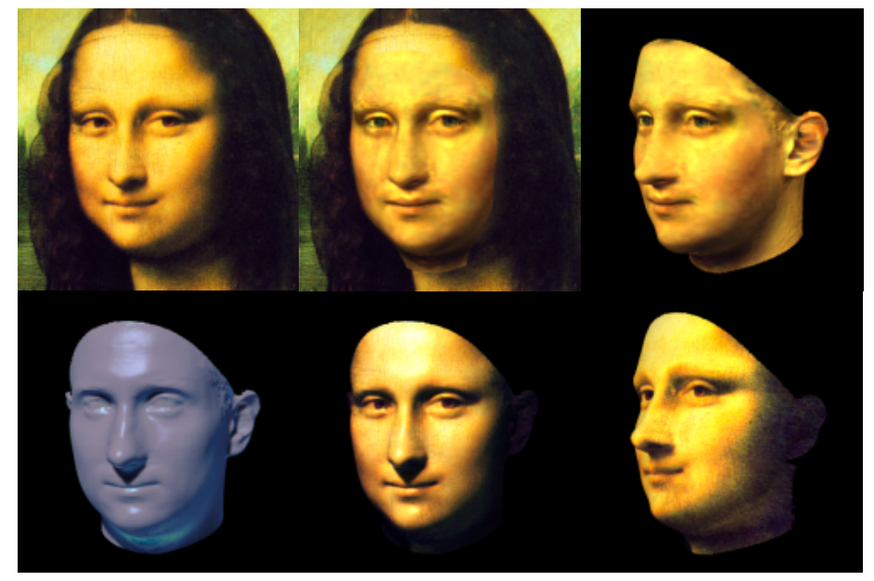
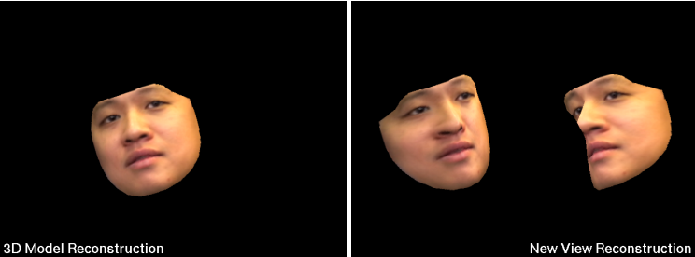
Face Reconstruction and Appearance Synthesis
J. Xiao, S. Baker, I. Matthews and T. Kanade, "Real-time combined 2d+ 3d active appearance models", CVPR, no. 2, pp. 535-542, 2004.
V. Blanz and T. Vetter, "A morphable model for the synthesis of 3d faces", Proceedings of the 26th annual conference on Computer graphics and interactive techniques, pp. 187-194, 1999.
2D photos and 3D molds
Math transformation
Notes:
The next focus is on facial reconstruction and appearance synthesis.
Previous studies have shown how to create 3D models from standard photos and generate new faces and expressions through math transformations.
发现2D AAMs可以模拟3D形态模型（3DMMs）能表示的任何现象，尽管可能需要更多的形状参数。论文进一步展示了如何使用非刚性结构从运动算法从2D AAM构建相应的3D形状模式，并如何将这些3D模式用于约束AAM，使其仅生成也能通过3D模式生成的模型实例
通过将一组3D人脸模型的形状和纹理转换为向量空间表示，形成了一个可变形的人脸模型，新的人脸和表情可以通过原型的线性组合来建模。

Slide 6
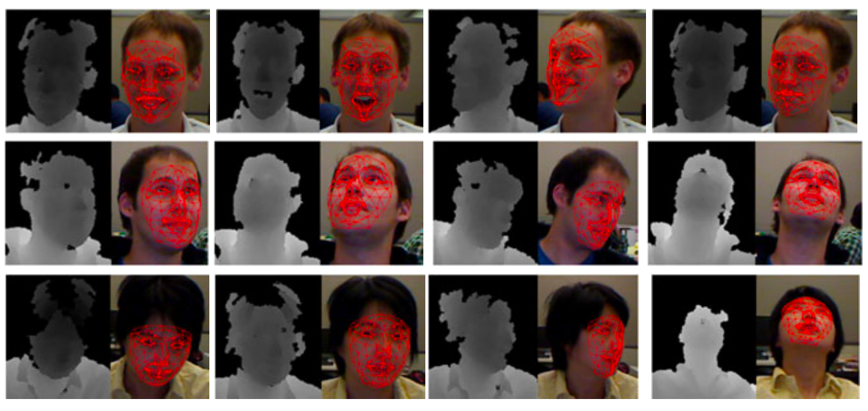
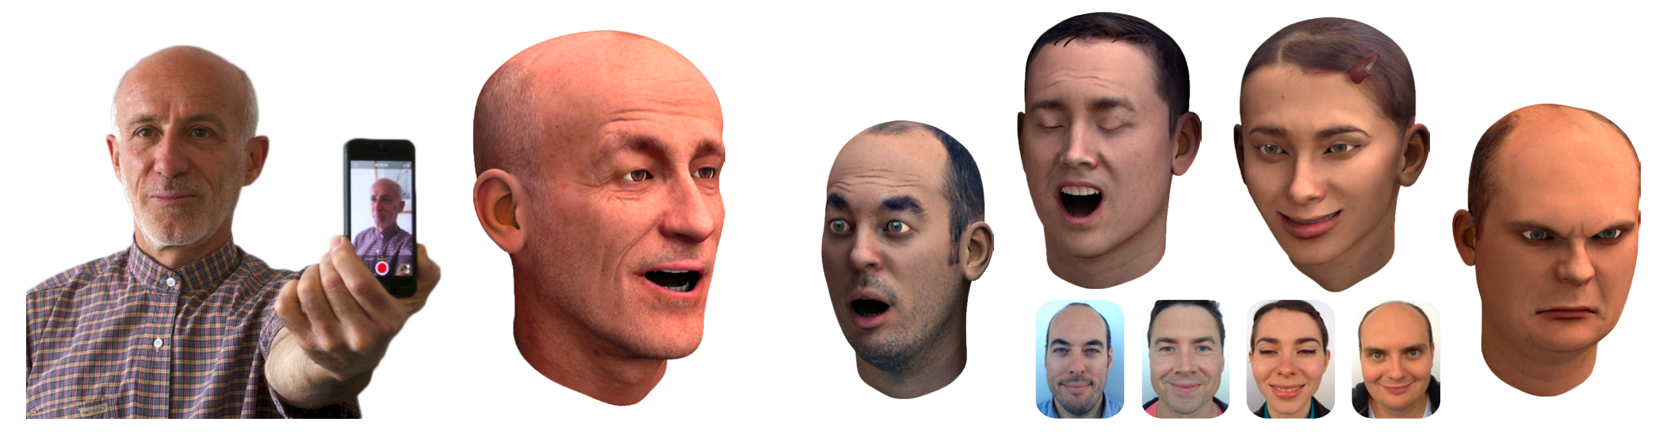
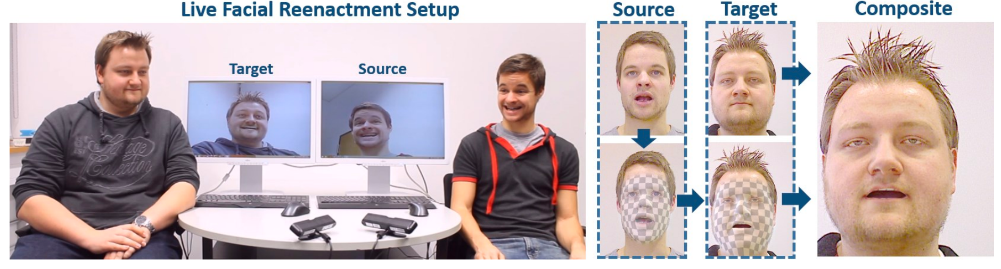
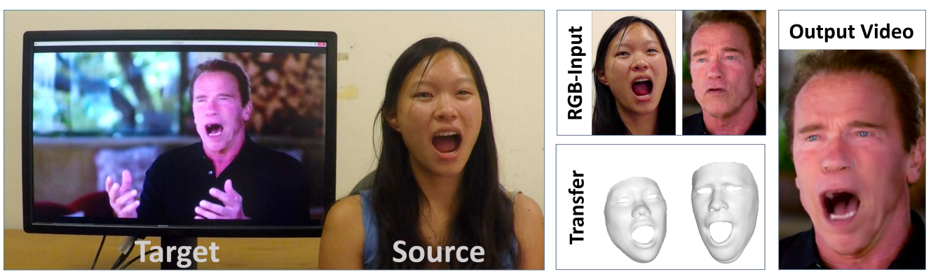
A. E. Ichim, S. Bouaziz and M. Pauly, "Dynamic 3d avatar creation from hand-held video input", ACM Transactions on Graphics (ToG), vol. 34, no. 4, pp. 45, 2015.
handhold devices
Q. Cai, D. Gallup, C. Zhang and Z. Zhang, "3d deformable face tracking with a commodity depth camera" in Computer Vision-ECCV 2010, Springer, pp. 229-242, 2010.
consumer-grade depth cameras
J. Thies, M. Zollhöfer, M. Stamminger, C. Theobalt and M. NieBner, "Face2face: Real-time face capture and reenactment of rgb videos", Proc. Computer Vision and Pattern Recognition (CVPR), 2016.
J. Thies, M. Zollhöfer, M. NieBner, L. Valgaerts, M. Stamminger and C. Theobalt, "Real-time expression transfer for facial reenactment", ACM Transactions on Graphics (TOG), vol. 34, no. 6, pp. 183, 2015.
RGB-D
Monocular RGB cameras
Notes:
Techniques for tracking facial models using handheld video devices and consumer-grade depth cameras have been developed.
Later researchers proposed a real-time facial reproduction technique. This technique captures the facial expression of the source subject and delivers it to the target person. At first they used RGB-D cameras. Later they were able to achieve the same result using only monocular RGB cameras. This significantly reduced costs. It further laid the groundwork for the headset removal work later on.

Slide 7
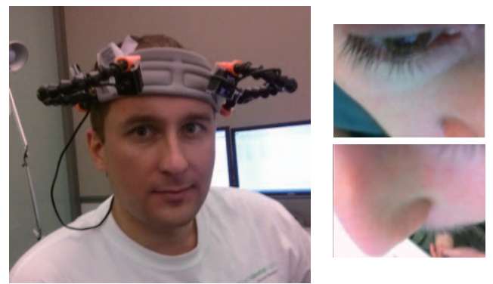
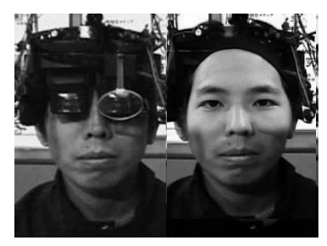
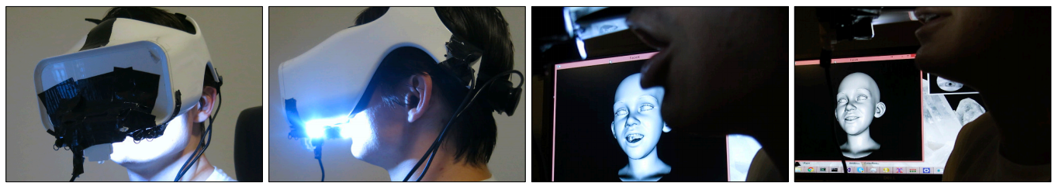
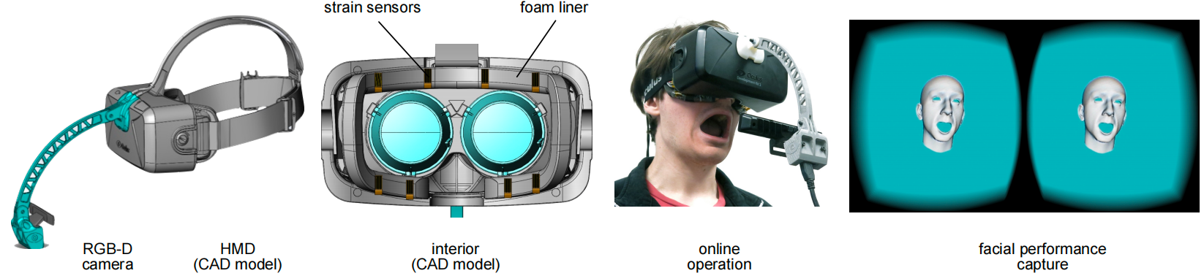
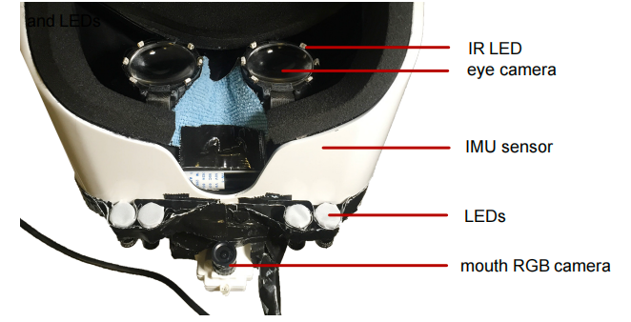
Headset Removal
B. Romera-Paredes, C. Zhang and Z. Zhang, "Facial expression tracking from head-mounted partially observing cameras", 2014 IEEE International Conference on Multimedia and Expo (ICME), pp. 1-6, 2014.
M. Takemura, I. Kitahara and Y. Ohta, "Photometric inconsistency on a mixed-reality face", Proceedings of the 5th IEEE and ACM International Symposium on Mixed and Augmented Reality, pp. 129-138, 2006.
K. Olszewski, J. J. Lim, S. Saito and H. Li, "High-fidelity facial and speech animation for vr hmds", ACM Transactions on Graphics (Proceedings SIGGRAPH Asia 2016), vol. 35, no. 6, December 2016.
H. Li, L. Trutoiu, K. Olszewski, L. Wei, T. Trutna, P.-L. Hsieh, et al., "Facial performance sensing head-mounted display", ACM Transactions on Graphics (TOG), vol. 34, no. 4, pp. 47, 2015
Notes:
The final area is headset.The research team synthesized facial images with arbitrary poses and eye expressions in real time by using several photos of the user and overlaying these facial images on the user's HMD,but it often leads to color inconsistencies.
Advances involved mounting cameras and sensors on headsets, using deep learning to predict and project user expressions onto virtual avatars, although this raised costs.

Slide 8
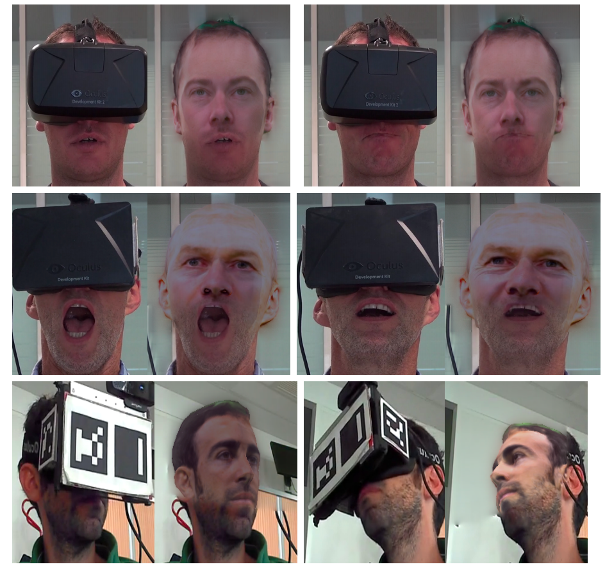
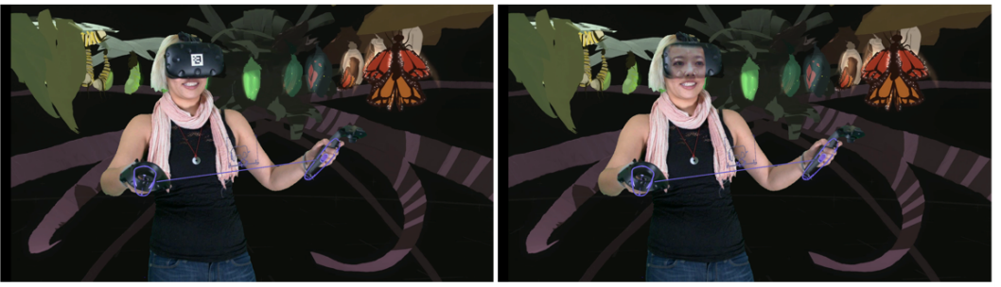
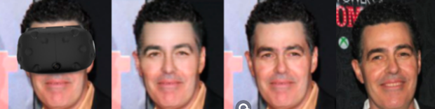
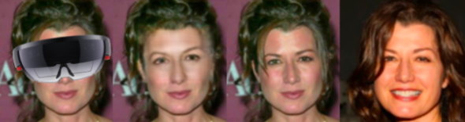
In-place headset removal
C. Frueh, A. Sud and V. Kwatra, "Headset removal for virtual and mixed reality" in ACM SIGGRAPH 2017 Talks, ACM, pp. 80, 2017.
Integrated eye tracking technology
X. P. Burgos-Artizzu, J. Fleureau, O. Dumas, T. Tapie, F. LeClerc and N. Mollet, "Real-time expression-sensitive hmd face reconstruction" in SIGGRAPH Asia 2015 Technical Briefs, ACM, pp. 9, 2015.
Constructing and projecting 3d models
Deep Learning Based Facial Image Repair Method
Notes:
The previously mentioned paper focuses on capturing and reconstructing the wearer's facial expressions through technical means but that does not involve visually removing the occlusion of the headset.
In-place headset removal aims to visually "erase" the headset, showing the wearer's real expressions and movements. Techniques include creating 3D head models from photos and tracking the headset to align head poses, but challenges remain, such as generating lifelike eyes and overcoming resolution and quality issues in facial imaging due to data and network limitations.
之前提到的论文主要是通过技术手段捕捉和重建穿戴者的面部表情，并将这些表情映射到一个虚拟角色上，这个过程并不涉及到在视觉上消除头戴设备的遮挡。
原位头盔移除技术是指在不真正取下头戴设备的情况下，通过虚拟手段让人们能够看到佩戴者的面部。这种技术试图在视觉上“消除”头戴设备的遮挡，让人们可以看到穿戴者的真实面部表情和头部动作。
这篇文章介绍了一种新方法，能够实时重建佩戴头戴显示器（Head-Mounted Display, HMD）的用户的面部。首先，通过一系列照片构建用户头部的3D纹理模型。然后，通过校准相机和实时追踪HMD的位置，将模型投影到视频帧上，精确模仿用户的头部姿态。最后，通过图像修补技术，无缝移除HMD并替换被遮挡的面部部分。但是因为他们用的是照片，文章提到的方法在处理眼神和眼球运动方面存在限制，这可能影响面部表情的自然度和真实感。此外，合成的面部内容中颜色调不一致的问题可能会影响结果的视觉协调性和真实性。
这篇文章的方法通过集成眼动追踪技术，能够生成透明的头盔效果，提升用户眼神交流，增强沟通和交互的自然度。但是，这项技术并不能完全移除头盔，因为恢复的面部纹理是直接投影到头盔表面的。
这篇论文提出了一种基于深度学习的面部修复方法，用于在大面积眼区遮挡情况下合成完整的面部图像。该方法能够在保持面部身份的同时处理不同的头部姿势，并且在视频序列中生成连贯的面部修复效果。并且由于网络能力和训练数据的限制，合成结果的分辨率和质量可能会导致模糊的输出。

Slide 9
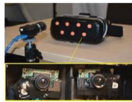
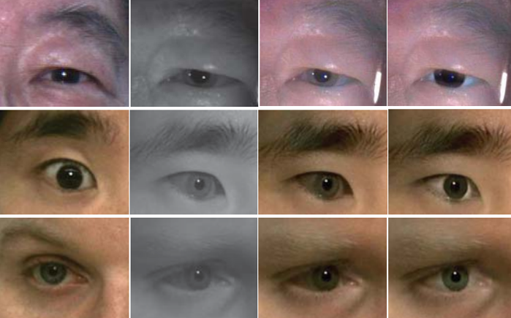
Main Idea：
1:
Develop a setup that consists of two near-infrared (NIR) cameras inside the HMD for eye capturing and one external RGB camera for recording visible face regions.
2:
A dedicated algorithm is proposed to colorize the NIR eye images and further rectify the color distortion caused by the non-linear mapping of IR light sensitivity.
Notes:
30ss
We can see from these previos papers, there are still some problems. To start with, thet can`t track eyeballs and the hardware they use is way too expensive, besides, the image they generate has severe color distortion aroud the eyeballs.
So now I`m gonna introduce you this paper we selected which improves all these problems.

Slide 10
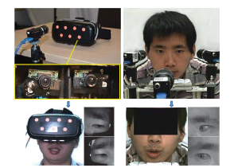
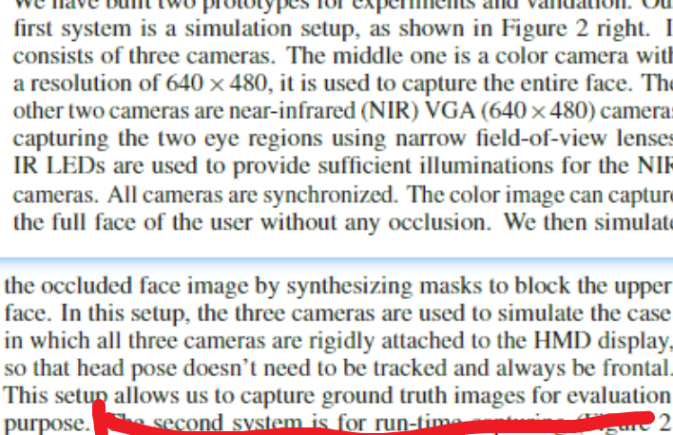
Hardware Setup：
our
GT
Notes:
右边用来获得gt，具体就是配置和论文配置一样，rgb得到真的图像，然后后期再加上一块黑的

Slide 11
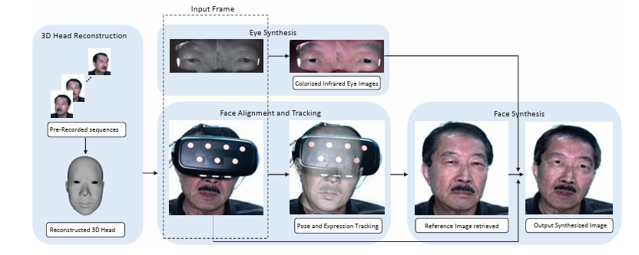
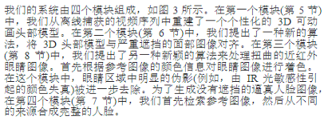
SYSTEM OVERVIEW:
Notes:
这里结束 总计2 min
in the first module, they reconstruct a personalized 3D animatable head model from a video sequence captured offline.
In the second module we propose a novel algorithm to align 3D head model to the face image with severe occlusion.
In the third module we propose another novel algorithm to process the warped near-infrared[ˌɪnfrəˈred] eye images
In the fourth module they retrieve the reference image and then compose the complete face from different sources.

Slide 12
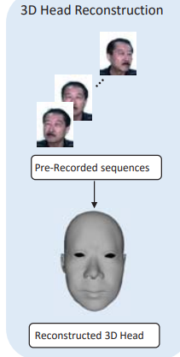
First Module：
3d head reconstruction
Step 1、Record a video sequence of the user with neutral expression under various head poses
Step 2、Apply the approach in ref [14] to estimate a sparse point cloud. A bi-linear face morphable model is then used to reconstruct a dense 3D model.
Notes:
一： 30s

Slide 13
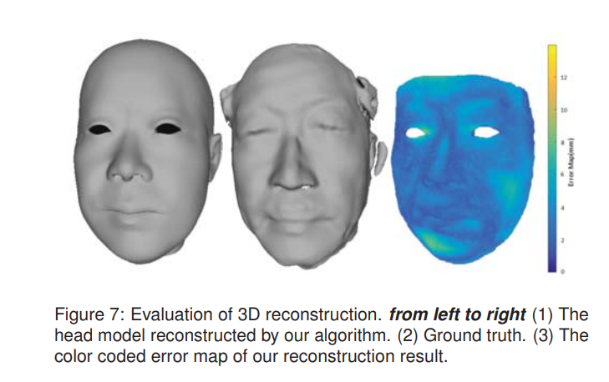
result：
Notes:
至此 2.5min

Slide 14
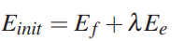
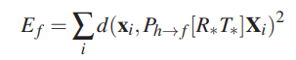
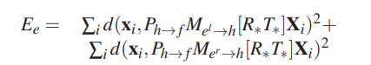
Second Module：
Alignment and Tracking
Step1、Extract the facial landmarks from both the color and IR images
Step2、Initial Alignment:
Estimate the transformation (represented as rotation R∗ and translation T∗) between the 3D head model and the HMD .
How: The user is instructed to change head pose with a neutral expression each time they put on the HMD.
How exactly: The alignment is formulated as a non-linear minimization problem
Notes:
第二部分【3 steps】
1.5 min
Step2中
第一条what 第二条how
第三条具体怎么算：
The first term Ef is the projection error
which measures the Euclidean distance between visible facial features in the 2D image and the corresponding 3D points of the head model projected into the camera view.
The second term Ee is the eye movement error
which measures the error between eye features in the 2D image from NIR and the corresponding 3D points of the head model (transformed through the eye camera's transformation matrices.)

Slide 15
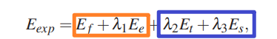
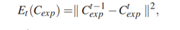
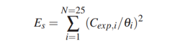
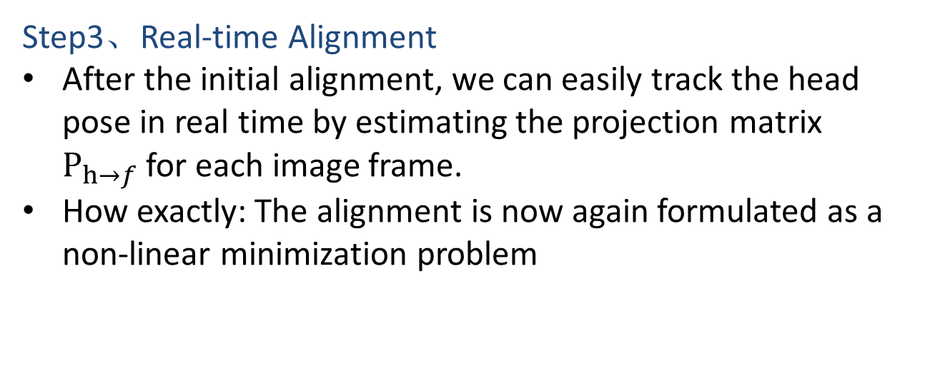
Step3、Real-time Alignment
After the initial alignment, we can easily track the head pose in real time by estimating the projection matrix $P_{h→f}$for each image frame.
How exactly: The alignment is now again formulated as a non-linear minimization problem
step2
Notes:
Et:
This term is the constraint term used to represent the temporal continuity of expression weights between consecutive frames.
It​ ensures that the changes in facial expressions from one frame to the next are smooth and not abrupt.
Es:
This term is the regularization term used to forces the expression weights to be close to the statistical center.
It adds a penalty for expression weights that are far from a precomputed statistical norm(thereby avoiding unlikely facial expressions that do not conform to the learned model of expressions.)

Slide 16
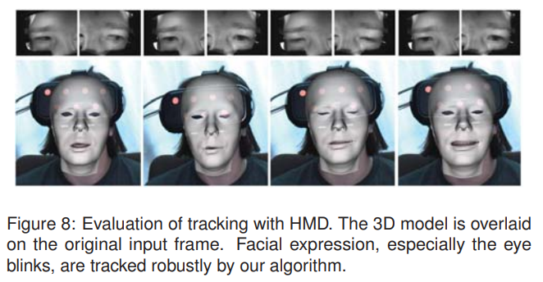
Result：

Slide 17
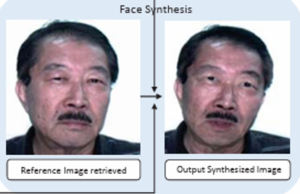
Fourth Module： Face Synthesis
Step 1、Through the current head pos, they first search for a reference image from the data set they have captured off-line.
Step 2、Then they apply a two-step warping to warp both the template image and the NIR eye images.

Slide 18
Step1：
Goal: Retrive Reference Image
How: The similarity between ith image in the data set and the query image is measured based on three distances
Notes:
1.5 min
Step1:
The first term is the distance between head poses of the query image and the reference image candidate
The second term is the distance between 2D facial landmarks of the selected reference image in previous time frame (Lr−1) and current reference image candidate (Li r).
This term removes large 2D translation between two consecutive image frames even they have similar poses.
The third term is defined so that current image candidate and previous reference image have close time stamps which ensures continuous.

Slide 19
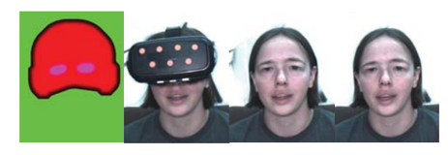
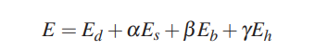
Step2:Face and
Eye image wraping
How:
2.1 :
As the 3D head model have been estimated and aligned with both the reference image and the query image separately, we use 3D model as a bridge to warp reference image to align with query image.
We compute our wrapping transform by minimizing this Energy Function.
2.2
Blend the query image which is partially blocked by HMD, warped reference image, and two colorized eye images together.
Notes:
Step2:
Ed​: data term ensuring that the pixel values are not distorted beyond the effects of the bilinear interpolation.
Es​: similarity transformation term that ensure that the warped image preserves the geometric features of the face.
Eb​: This term is used to reduce the transformation outside the face region.
Eh​: This term is introduced to constrain the silhouette of the face in the image 即ensuring a smooth transition and avoiding artifacts along the silhouette[ˌsɪluˈet] of the face.
图的解释；
1) The mask used to blend images from different sources. The green region represents the background we would like to keep in the final result. The red region represent the head region that is extracted from the warped reference image. The purple region is the region corresponding to the NIR eye images
2) The query image with the face occluded by the HMD.
3) The blending result of the query image, warped reference image, and colorized eye images.
4) The final blending result after background replacement

Slide 20
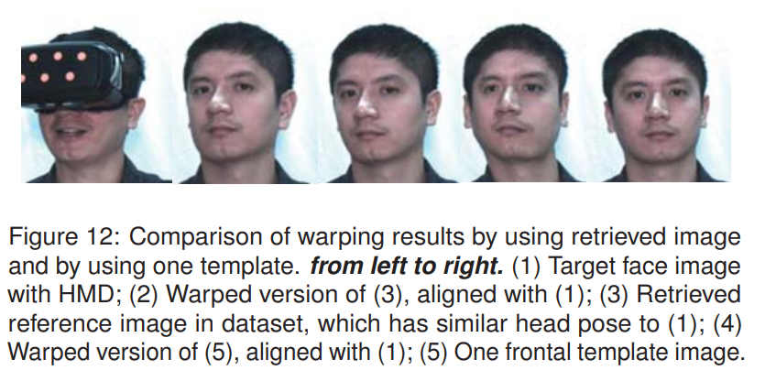
Result：

Slide 21
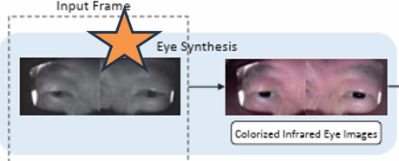
Third Module：
Eye Synthesis(colorize the warped NIR eye images)
Step1、They colorize the eye images based on the color information from the reference image.
Step2、They further refine the eye regions by removing obvious artifacts (e.g., IR color distortion) during the colorization

Slide 22
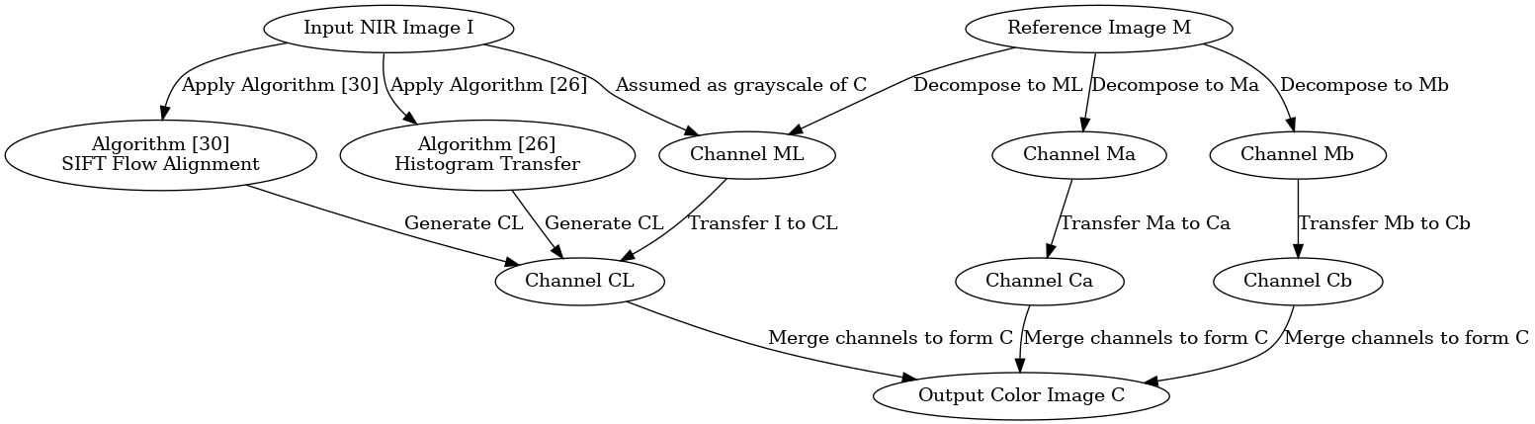
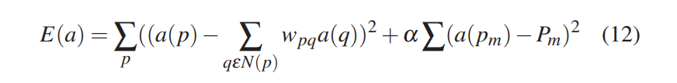
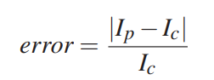
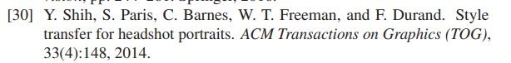
Step1、colourization
[L*a*b* color space]
Step1.1：get L channel
Step1.2: get a & b channel
Minimizing the following equation：
Notes:
1.5min
The problem is solved in LAB color spaces where L:luminance a:green b: blue
Here, We denote the input NIR image as I, the reference image as M, and output color image as C.
第一步中：这里是两种截然不同的方法！
Two existing algorithms [26, 30] are applied and evaluated
The first algorithm [26] is a straightforward histogram transfer based on the standard deviations and mean values of Lchannel of I and M.
While In the second algorithm [30], the images I and M are aligned based on the landmarks and the SIFT flow and are decomposed into multiscale Laplacian stacks which are updated by the gain maps and are aggregated to generate CL.
The second one performs better but is time-consuming
第二步中：
第一个Equation 的目的是：
This equation minimizes the difference between the color at pixel p and its weighted averages of the neighboring pixels. The weight wpq is computed based on CL and statistics of the local patch around p. Pm are the pre-defined seed pixels
第二个equation
IF we only use the first equation, we will still get obvious artifacts.
The second equation removes that using a voting scheme to remove the unreliable seed pixels. We first run adaptive k-means clustering to segment the image M at gray scale level. Then we only select seed pixels with high confidence that is measured by
where Ip is the intensity value of pth pixel in I and Ic is the intensity value of the center of each segment.

Slide 23
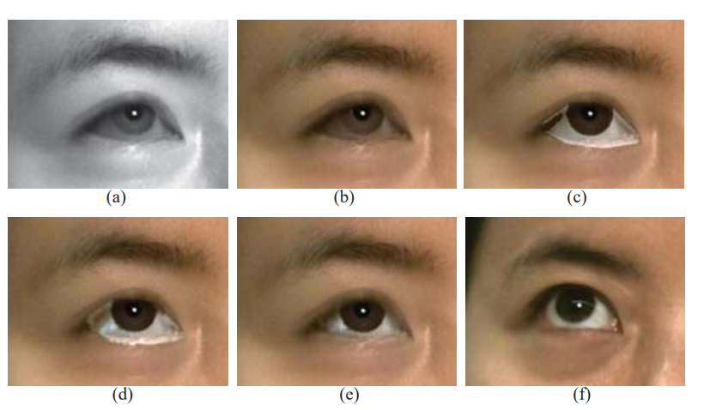
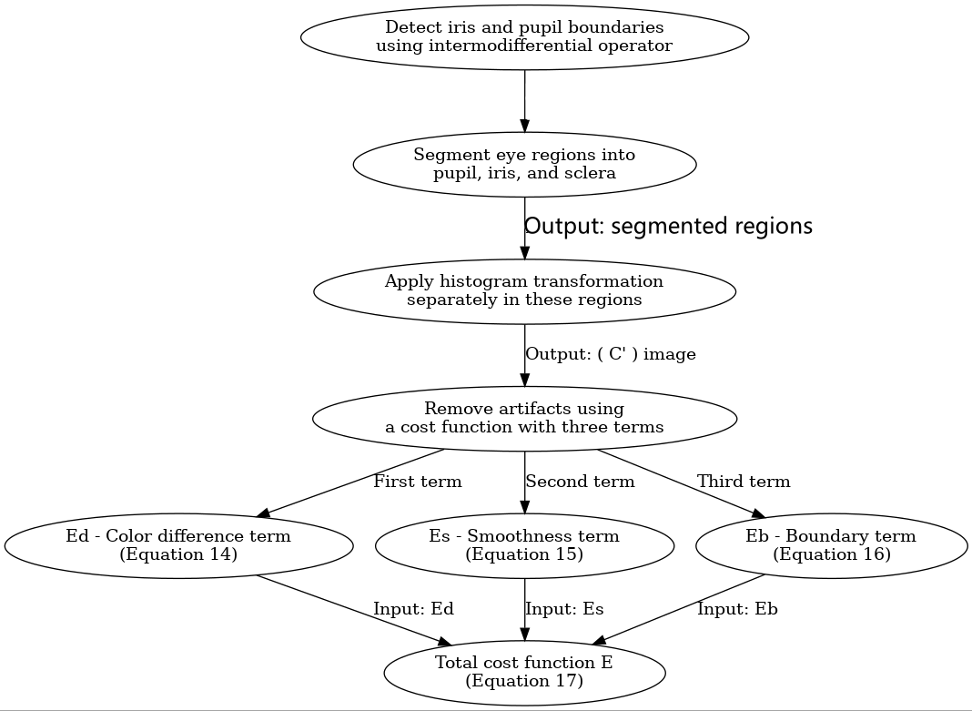
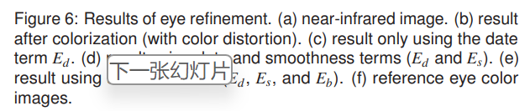

Step2、Refinement of
eye regions
Notes:
1.5 min
After the last step, the result still contains very strong IR color distortion effects
第一个框：分区域在histogram transform
First & Second:
detect iris and pupil !boundaries! in both nir images and color. Combining with the eye landmarks, we segment the eye regions into three categories, pupil, iris, and sclera.
Third:
Then apply histogram transformation separately in the regions of these categories.
This result partially removes color distortion effects. However, it introduces strong artifacts around boundaries of these categories and makes the result unnatural.
第二个框 FOURTH: In order to remove the artifacts, we formulate a minimization based on a cost function with three terms。
The first term Ed is the data term that color an unknown pixel same as the seed pixel in the input image.
Es is the smoothness term
and the last term Eb is the Poisson equation with Dirichlet boundary conditions inspired by the gradient image editing

Slide 24

Result：

Slide 25


Result of the Real System:
Notes:
Simulation Results. (1st column) are the input images with eye images shown at the bottom of each face image.
(2nd column) are the synthesized face images by our system.
(3rd column) are the ground truth images.
(4th column) are the error maps between ground truth and synthesized image

Slide 26

Result of the Real System(Far range)

